Slide 1

Mathematics for Programming

Slide 2
Recap
GCD and LCM
Euclidean algorithm for GCD (and LCM too)
Factorials and a combinatorial problem
Matrices and an application of them
Power and roots
Sets and set operations

Slide 3
Basic Geometry
Points and lines
Coordinate System
Angles
Some geometric shapes

Slide 4

Point
Just a dot
Location only
No length, width, shape, size
This is a point

Slide 5
Line
Two different points
Connect them
Take the straight path
Also the shortest
This is called line segment
Finite length
Line: extended in both ends
Infinite length
Ray: extended in one end
Infinite length

Slide 6
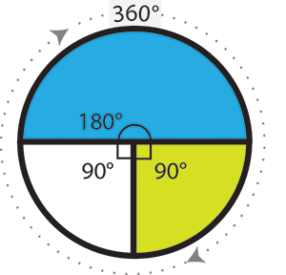
Angle
Between two rays extending from the same point
Circular arc to annotate
Full rotation = 360 degrees
Angle

Slide 7



Angle
Acute Angle (<90$°$)
Right Angle (=90$°$)
Obtuse Angle (>90$°$)

Slide 8
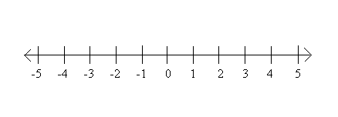
Coordinate system
How do you navigate in real life?
Reference point, directions, distance etc
How to identify a point in space?
Coordinate System!
Remember number line? One-dimensional coordinate system.

Slide 9
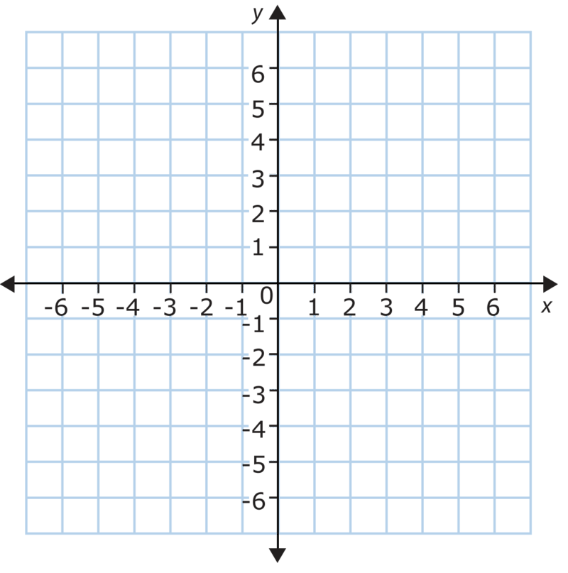
Coordinate system
2D coordinate system
Take two perpendicular lines
Right angle / 90 degrees
Horizontal: X axis
Vertical: Y axis
Intersecting point: Origin (0,0)
Any point can be identified as a pair of numbers
(x,y)
Where is (-2, 5)?

Slide 10
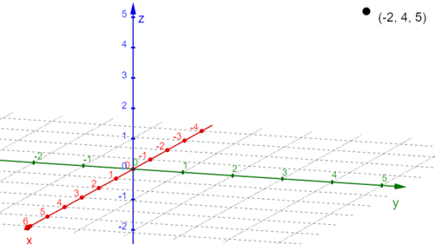
Coordinate system
How about 3D coordinate system?
(x,y,z)
Hard to visualize on paper
But easier in real life

Slide 11


Triangle
3 points and 3 line segments
Sum of three angles = $180°$
Area = $\frac{1}{2}∗base ∗height$
height
base

Slide 12
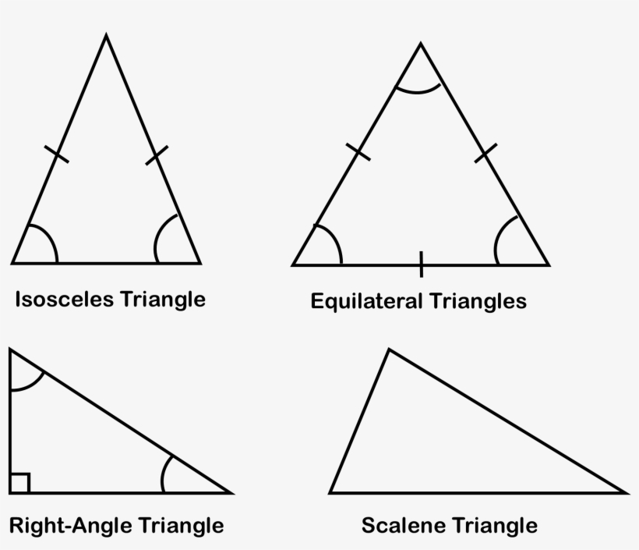
Triangle
Based on equality between sides
Equilateral
Isosceles
Scalene

Slide 13


Square
4 points and 4 line segments
All sides are equal
Each angle is $90°$
Sum of four angles is $360°$
Area: ${\left(side_length\right)}^{2}$
Length of diagonal: $\sqrt{2} × (side_length)$

Slide 14
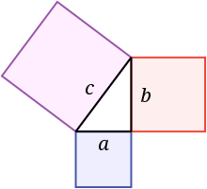

Pythagorean theorem
Pythagorean theorem
$c^{2}=a^{2}+b^{2}$
Right-angle triangle and square
Example:
$5^{2}=3^{2}+4^{2}$
${13}^{2}=5^{2}+{12}^{2}$

Slide 15
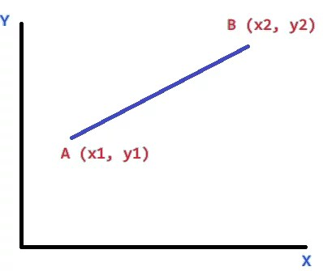

Distance between two points
Can you apply Pythagorean Theorem to get distance between A and B?
$d_{AB}=\sqrt{{\left(x_{1}−x_{2}\right)}^{2}+{\left(y_{1}−y_{2}\right)}^{2}}$

Slide 16


Rectangle
4 points and 4 line segments
Opposite sides are equal
Each angle is $90°$
Sum of four angles is $360°$
Area: $length × height$

Slide 17

Circle
Center
Radius
Diameter
Area = $π×{\left(radius\right)}^{2}$
radius

Slide 18
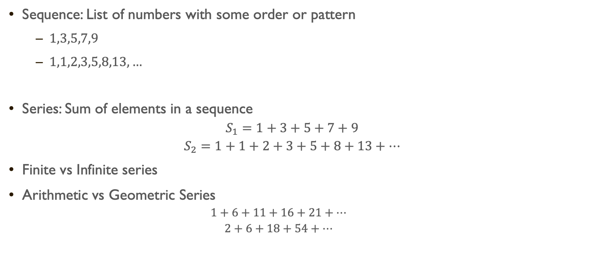
Series
Sequence: List of numbers with some order or pattern
$1,3,5,7,9$
$1,1,2,3,5,8,13,…$
Series: Sum of elements in a sequence
$$S_{1}=1+3+5+7+9$$
$$S_{2}=1+1+2+3+5+8+13+…$$
Finite vs Infinite series
Arithmetic vs Geometric Series
$$1+6+11+16+21+…$$
$$2+6+18+54+…$$

Slide 19

1+2+3+…+N = ?
$1+2+3+4+5= ?$
Let,
$$S=1+2+3+4+5$$
$S=5+4+3+2+1$
$\left(+\right), 2S=6+6+6+6+6$
$2S=5×6$
$S=15$

Slide 20

1+2+3+…+N = ?
$1+2+3+…+N= ?$
Let,
$$S=1+2+3+…+N$$
$S=N+\left(N−1\right)+\left(N−2\right)+…+1$
$\left(+\right), 2S=\left(N+1\right)+\left(N+1\right)+\left(N+1\right)+…+(N+1)$
$2S=N×(N+1)$
$S=\frac{N×\left(N+1\right)}{2}$

Slide 21
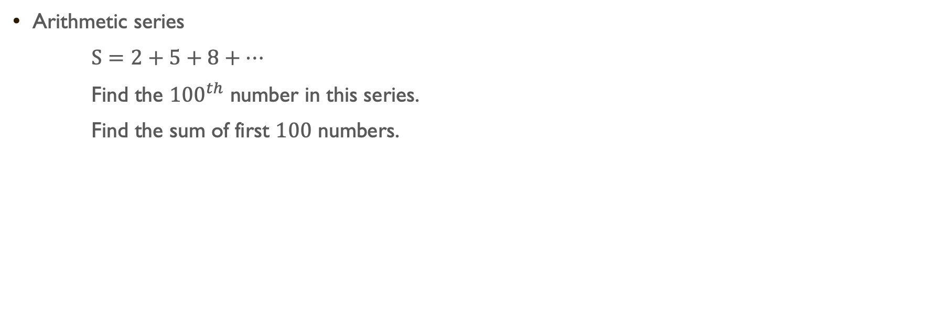
Series (Finite Sum)
Arithmetic series
$S=2+5+8+…$
Find the ${100}^{th}$ number in this series.
Find the sum of first $100$ numbers.

Slide 22

Series (Finite Sum)
$n^{th}$ term in arithmetic series: $a+\left(n−1\right)×d$
$→ {100}^{th}$ number = $2+99×3=299$
Sum of first $n$ terms: $\frac{n}{2}\left\{2a+\left(n−1\right)×d\right\}$
$→$sum of first $100$ numbers = $\frac{100}{2}\{2×2+(100−1)×3\}=15050$

Slide 23
Summary
Basic Geometry
Points – Lines
Rectangle – Square
Circle
Coordinate system
2D and 3D – Distance between points
Sequence and Series
Finding sum of series

Slide 25

Practice Day
Find the straight line (shortest) distance between two points in a 3-dimensional space.
Points: $A(−10,23,5) \& B(31, −11, 76)$
Find the area of the green region if the side length of the square is $10$
Find the sum of first $n$ odd numbers. Calculate for $n=10,100,1000$

